Slide 1

Online HandiCrafts Store
Team Members:
Rani Isvarya.N
Vijatha.S
Priya Mahalakshmi.S
Shameli .K
Guided By:
Divya.T

Slide 2
Outline
AIM
PROBLEM STATEMENT
INTRODUCTION
EXISTING SYSTEM
BLOCK DIAGRAM
UNIQUNESS
MODULES
PROPOSED SYSTEM

Slide 3
AIM:
To create web pages online.
Aesthetic user interface , making it an enriching experience for creation of web pages.
It is an initiative to boost the demand and popularity.

Slide 4
PROBLEM STATEMENT
      Our mini project depends upon the domain Web Development
      Developing an application with facilities of ensuring the quality based product by handicrafts by sellers through online to customers.

Slide 5
INTRODUCTION
Introducing best place for customers to buy more efficient items through our website.
We can know more information about unknown product which can make better life for each individual.
Better place for exploring the hobby into business to make profit.

Slide 6
EXISTING SYSTEM
The products are of good quality.
No time limits in online shopping , so you can get customer 24/7.
Give them what they are looking for.
Handcrafted products support a tradition of skilled work.
Handcrafted products are easier to buy and more popular than ever.

Slide 7
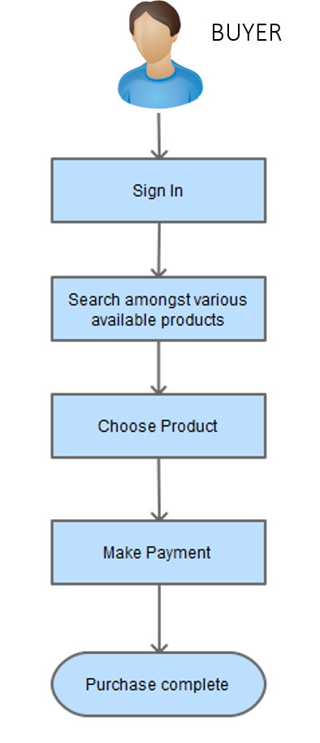
BLOCK DIAGRAM

Slide 8
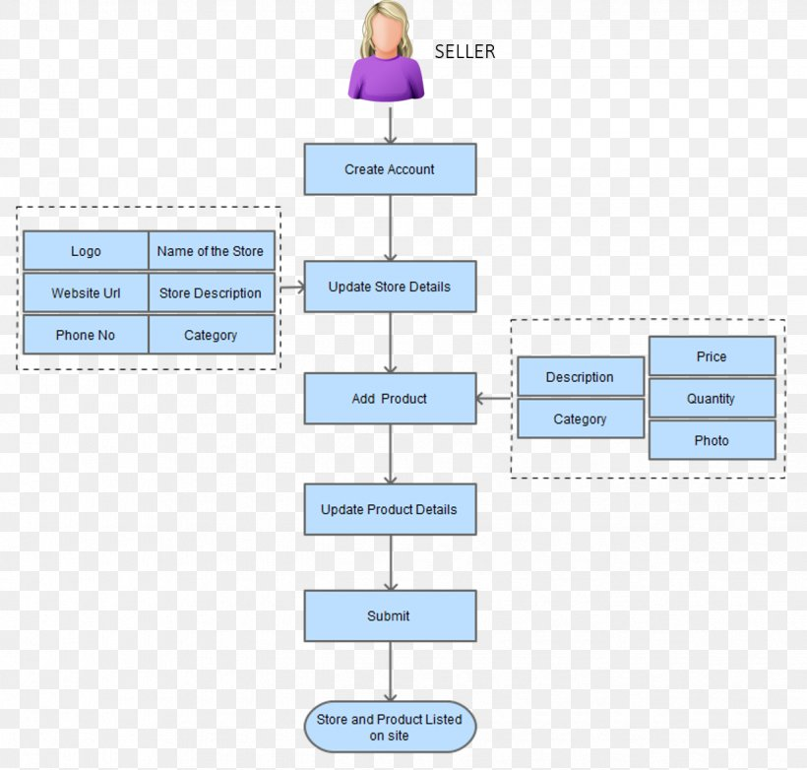

Slide 9
UNIQUENESS
Each item is a unique display of craftsmanship.
When you buy handmade product , you are buying a commitment of authenticity , a guarantee that no other piece will ever be the same.
Handicraft goods are often of good quality where as machine made good are of lesser quality.

Slide 10
MODULES
HTML(Hyper Text Markup Language)
CSS(Cascading Style Sheet)
JS(Java Script)
JAVA
MYSQL

Slide 11
PROPOSED SYSTEM
It depicts the art and culture of the society and keeps alive the rich culture.
It is environmental friendly.
You can work and sell from the comfort of your home.
Handcrafted products make you feel good about your purchases.
Handicraft also provide lots of practice in eye-hand coordination.
Handicrafts gives the artist a self - employment and to convert it to a big business.

Slide 12


